Slide 1


4x4 training
portfolio
Done by:
Varanasi Vaishnavi
21WU0101051
B. Tech - DS & AI

Slide 2
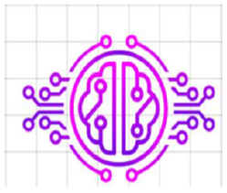
ABOUT
CEREBRATECH
"We’re thrilled to have you onboard as part of our growing community. Together, let’s innovate, learn, and build solutions for tomorrow!"
"Cerebra Tech is a dynamic startup specializing in developing end-to-end projects using modern technologies.“
"Our mission is to deliver impactful solutions while fostering a culture of innovation and continuous learning."

Slide 3

Day - 1
Python Programming Bootcamp
Overview:
The entire Python programming course was covered in one intensive session. The experience was engaging and insightful, making it easy to grasp the concepts quickly.
Assignments: Worked on 13 hands-on assignments designed to cover all major Python topics comprehensively.
Key Topics Covered:
Basics of Python: Variables, data types, and operators.
Control Flow: If-else statements, loops, and nested constructs.
Functions: Creating reusable code blocks and working with parameters.
Data Structures: Lists, tuples, dictionaries, and sets.
Object-Oriented Programming (OOP): Classes, objects, inheritance, and polymorphism.

Slide 4
Day - 2
mysql
Overview:
Focused on understanding MySQL and its usage for managing relational databases.
Work done:
Learned MySQL Fundamentals: Covered basic SQL operations such as SELECT, INSERT, UPDATE, DELETE, and JOIN, as well as understanding database schema, normalization, and relationships between tables.
Practice Questions: Completed 100 practice interview questions to solidify the concepts of MySQL. These questions helped in mastering query writing, database manipulation, and data retrieval techniques.
Solved 50 Challenging Questions: Tackled 50 questions from the training, applying advanced SQL concepts like subqueries, indexing, complex joins, and aggregate functions. This hands-on practice improved the ability to write efficient SQL queries and troubleshoot database-related issues.

Slide 5
Key Learning: Gained a deeper understanding of how relational databases work, how to manage large datasets, and how to optimize queries for performance.
Hands-On Practice
Writing a query to retrieve data from a table:
SELECT name, age FROM students WHERE age > 18;
Writing a query to retrieve data from a table:
INSERT INTO students (name, age, grade) VALUES ('John Doe', 20, 'A');
Joining two tables to fetch data from both:
SELECT students.name, courses.course_name FROM students INNER JOIN enrollments ON students.id = enrollments.student_id INNER JOIN courses ON enrollments.course_id = courses.id;
Using a subquery to get students who scored above average:
SELECT name, score FROM students
WHERE score > (SELECT AVG(score) FROM students);

Slide 6
Day - 3
Learning NumPy, Pandas, Matplotlib, and EDA (Exploratory Data Analysis)
Overview:
Focused on key data analysis libraries like NumPy, Pandas, Matplotlib, and along with performing Exploratory Data Analysis (EDA) on datasets. Covered topics like detecting outliers and addressing class imbalance.
Numpy:
NumPy is a Python library for efficient numerical computing, providing support for multi-dimensional arrays and matrices. It offers a wide range of mathematical functions for operations on large datasets.
import numpy as np arr = np.array([1, 2, 3, 4]) print(np.mean(arr)) # Calculate mean

Slide 7
Pandas:
Pandas is a Python library for data manipulation and analysis, providing flexible data structures like DataFrames and Series. It simplifies tasks like data cleaning, transformation, and exploration with intuitive indexing and powerful functions.
import pandas as pd
data = {'Name': ['Alice', 'Bob', 'Charlie', 'David'], 'Age': [25, 30, np.nan, 22]}
df = pd.DataFrame(data)
df['Age'].fillna(df['Age'].mean(), inplace=True)
# Fill missing values with mean
Matplotlib:
Learned how to visualize data using Matplotlib, creating different types of plots like line charts, bar charts, and histograms.
import matplotlib.pyplot as plt
x = [1, 2, 3, 4]
y = [10, 20, 25, 30]
plt.plot(x, y)
plt.title('Line Plot')
plt.xlabel('X-axis')
plt.ylabel('Y-axis')
plt.show()

Slide 8
Exploratory Data Analysis
(EDA):
Performed EDA to understand the dataset's structure, detect outliers, and handle class imbalance.
Outliers: Identified outliers in the dataset using statistical methods and visualizations.
Class Imbalance: Addressed class imbalance by applying techniques like resampling and using visualization methods to understand the imbalance.
from imblearn.over_sampling import SMOTE
X_resampled, y_resampled = SMOTE().fit_resample(X, y)
# Applying SMOTE for balancing classes
Key Learnings:
Data manipulation and visualization techniques using NumPy, Pandas, and Matplotlib.
Understood and applied key EDA techniques for identifying outliers and addressing class imbalance, which are critical for preparing data before applying machine learning algorithms.

Slide 9
Machine Learning:
Machine Learning is a branch of Artificial Intelligence (AI) that focuses on building systems capable of learning from data and improving their performance over time without explicit programming. ML algorithms analyze large datasets to identify patterns, make predictions, or take decisions based on input data.
Types of Machine Learning:
Supervised Learning
unsupervised Learning
Reinforcement Learning
Real-World Applications:
Healthcare
Finance
Retail
Transportation
Typical ML Workflow:
Data Collection
Data Preprocessing
Model Selection
Training
Evaluation
Deployment

Slide 10
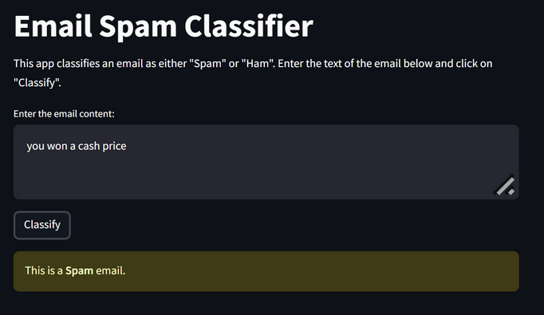
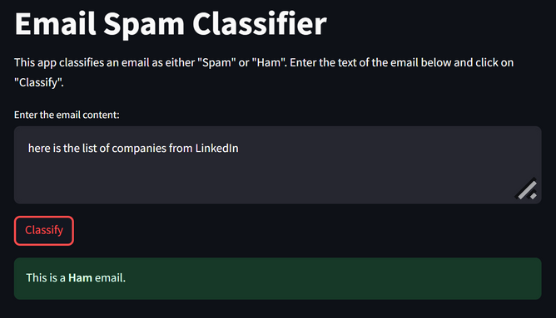
Machine Learning Project:
Email Spam Classifier
The goal of an email spam classifier is to categorize emails as:
Spam (Unwanted emails, promotional content, phishing emails) or
Ham (Legitimate, personal, or business-related emails).
This is a binary classification problem, and Logistic Regression is well-suited for this task because it predicts probabilities that can be converted into binary labels.
Dataset
Features: Typically, the email content (text) is used as the primary feature.
Target: Binary labels:
0 for Spam
1 for Ham
Common pre-processing steps include removing duplicates, handling missing values, and encoding categorical labels.

Slide 11
Day - 4
Deep Learning:
Key Topics Covered:
Introduction to Neural Networks
Activation Functions
Deep Learning Project:
Hand Digit Recognition:
Hand-written digit recognition aims to identify digits (0-9) from images, commonly using the MNIST dataset.
The process involves normalizing images, building a neural network model with layers like Flatten and Dense, and training it with a loss function such as Sparse Categorical Crossentropy.
After training, the model is evaluated for accuracy and can be deployed for real-time recognition tasks using libraries like TensorFlow and Keras.

